Slide 1
Boosting Algorithm
And types

Slide 2
Boosting Algorithm:
Boosting algorithm is ensemble technique improves the accuracy of the model by combining multiple weak learners to create a strong learners.
Step 1:
Analyse an draw decision separating the + and -
Step 2:
False prediction will move to next step and again checking.
Step 3:
Repeat the step 2 untill right prediction

Slide 3
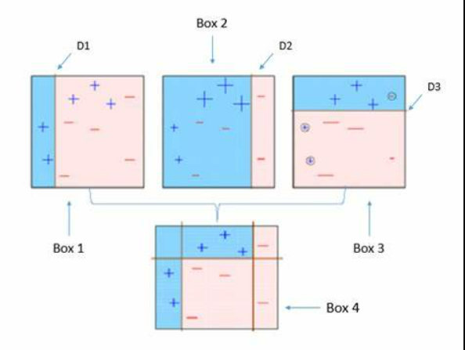

Slide 4
Advantage:
High Accuracy
Handles Complex Data
Reduced Bias
Flexibility
Handles Imbalanced Data
Disadvantage:
Risk of Overfitting
Sensitive to Noisy Data:
Memory Usage

Slide 5
Ada Boost Algorithm:
Ada Boost Algorithm is improves the performance of week classifiers by focusing on the instance that are hard to classify.
Step 1:
Same work as normal boosting algorithm
Step 2:
Transforming weak learners into strong learners
Step 3:
By giving increment weight concepts
Step 4:
Used for both classification and regression problems
;

Slide 6
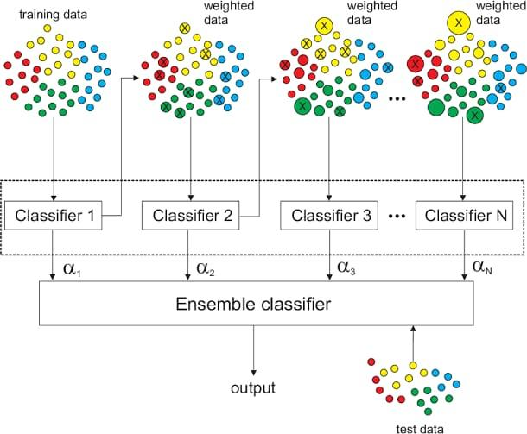

Slide 7
Advantage:
Improves Weak Learners
good generalization on unseen data
Disadvantage:
If weak learners are too weak (barely better than random guessing), AdaBoost may struggle to improve the model's performance.

Slide 8
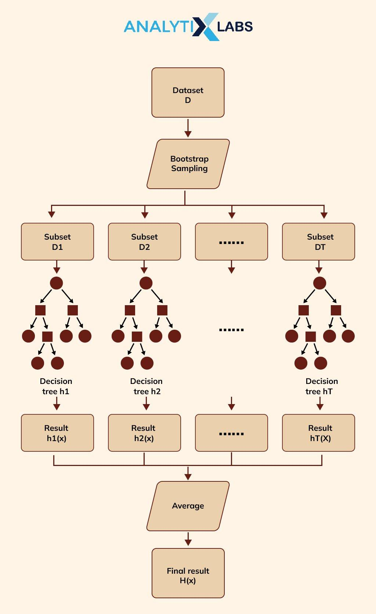
XG Boost Algorithm
Same as gradient boosting but has different functionality
Disturbed machine learning process
More computational speed and efficiency
Advantage:
XGBoost is known for its high performance in terms of both speed and accuracy
XGBoost includes built-in regularization (L1 and L2) to control overfitting
Disadvantage:
High Memory Usage
XGBoost can be difficult to debug if something goes wrong

Slide 9
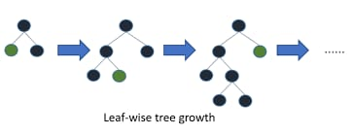
LG Boosting Algorithm:
Huge amount of data easy handle
Poor in smaller dataset
It uses histogram based method for selecting best fit method
For continuous values
Advantage:
LightGBM is designed for speed and efficiency
LightGBM performs particularly well on large datasets
histogram-based approach used by LightGBM reduces memory consumption
Disadvantage:
The benefits of its optimizations are less noticeable when dealing with small data.
performance is highly dependent on the correct tuning of hyperparameters

